Slide 1
Wrapper classes
In Java

Slide 2
We see many applications on the internet that receive data from one user and send it to the server.
For example in business application. We type our details like name, credit card number, address etc. and send them to the server.
The server expects the data in the form of objects and hence we supposed to send objects.
In our data, name is String type object, but the credit card number is just an int type value which is not an object.
The primitive data type should also be converted into an object and then send to server.
To do this we need a wrapper classes.

Slide 3
A wrapper class contains a field where it stores the primitive data type.
When we create an object to a wrapper class, it carries the primitive data type with it and hence the object can be sent o the server.
Another reason is ,in java collection classes are defined in java.util package which handles only objects, not the primitives.
Hence if we want to use collection classes on primitives, we should convert them into objects. So we need wrapper classes.

Slide 4
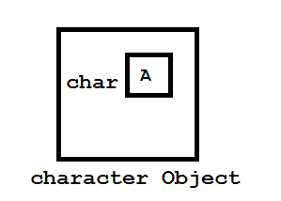
Wrapper class.
A wrapper class is a class whose object wraps or contains a primitive data type.
When we create an object to a wrapper class, it contains a field and in this field, we can store a primitive data type.

Slide 5
Interview questions
Why do we need wrapper classes?
They convert primitive data types into objects and this is needed on internet to communicate between two applications.
The classes in java.util package handle only objects and hence wrapper classes help in this case also.

Slide 6
We are having 8 primitive data types hence sun peoples are providing 8 wrapper classes.
Data types and corresponding wrapper classes:-
byte ----- Byte
short ----- Short
int ----- Integer
long ----- Long
float ----- Float
double ----- Double
boolean ----- Boolean
char ------ Character
Byte,Short,Integer,Long,Float,Double these are child classes of Number

Slide 7
Constructors of wrapper classes:-
All most all wrapper classes contain two constructors:-
1. Integer i=new Integer(10);
2. Integer i=new Integer(“10”);
Primitives | Wrapper classes | Following constructor arguments
byte short int long float double char Boolean | Byte Short Integer Long Float Double Character Boolean | Byte or String Short or String Int or String Long or String Float or double or String double or String Char Boolean or String

Slide 8
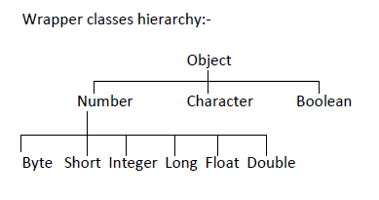
Number class is an abstract class and whose sub classes are Byte, Short,..etc. so methods of Number class are commonly available in all these sub classes.
byte byteValue()- converts calling object into byte value.
double doubleValue()- convets calling object into double value.
Long longValue()-converts into long value.
https://www.tutorialspoint.com/java/lang/java_lang_number.htm

Slide 9
Character class methods
The Character class of the java.lang package wraps a value of the primitive datatype char. It offers a number of useful class (i.e., static) methods for manipulating characters. You can create a Character object with the Character constructor.
Character ch = new Character('a');
Following are the notable methods of the Character class.

Slide 10
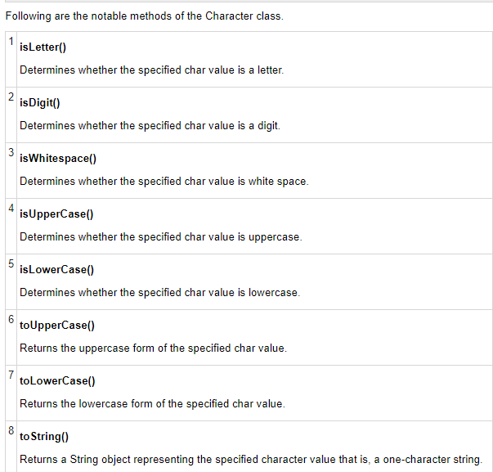
methods

Slide 11
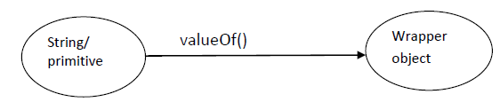
Utility methods
Utility methods of Wrapper classes | valueOf(), xxxValue(), parseXxx(), toString()
Utility methods of Wrapper classes:The objective of Wrapper class is to define several utility methods which are required for the primitive types. There are 4 utility methods for primitive type which is defined by
valueOf():-
By using valueof() we are creating wrapper object and it is a alternative to the constructor.

Slide 12
Example on valueOf()
Ex :-
class Test
{
public static void main(String[] args)
{
//by using constructor converting String/primitive to wrapper object
Integer i=new Integer(10);
System.out.println(i);
//by using valueOf() converting String/primitive to the wrapper object
Boolean b=Boolean.valueOf("true");
System.out.println(b);
}
}

Slide 13

XxxValue():- by using XXXValue() method we are converting wrapper objects into the corresponding primitive values.
class Test
{
public static void main(String[] args)
{
Integer i=Integer.valueOf(150);
System.out.println("byte value :"+i.byteValue());//-106
System.out.println("short value :"+i.shortValue());//150
System.out.println("int value :"+i.intValue());//150
System.out.println("long value :"+i.longValue());//150
System.out.println("float value :"+i.floatValue());//150.0
System.out.println("double value :"+i.doubleValue());//150.0
Character c=new Character('s');
char ch=c.charValue();
System.out.println(ch);
Boolean b=new Boolean(false);
boolean bb=b.booleanValue();
System.out.println(bb);
}
}

Slide 14
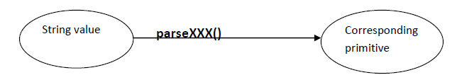
parseXXX():- by using above method we are converting String into the corresponding primitive.
class Test
{
public static void main(String[] args)
{
String str1=“Hello";
String str2="20";
System.out.println(str1+str2);//1020
int a=Integer.parseInt(str1);
float f=Float.parseFloat(str2);
System.out.println(a+f);//30.0
}
}
Exception in thread "main" java.lang.NumberFormatException: For input string: "Hello"
at java.lang.NumberFormatException.forInputString(Unknown Source)
at java.lang.Integer.parseInt(Unknown Source)
at java.lang.Integer.parseInt(Unknown Source)
at wrapper.Parse.main(Parse.java:12)

Slide 15
toString():-
class Object
{
Public string toString()
{
return getClass@hashcode;
}
};
class WrapperClasses extends Object
{
//overriding the toString()
Public string toString()
{
return the corresponding value
}
};

Slide 16
Example
package wrapper;
class Test2
{
}
public class ToString {
public static void main(String[] args) {
// TODO Auto-generated method stub
Test2 t = new Test2();
System.out.println(t.toString());
Integer i=new Integer(10);
System.out.println(i.toString());
Float f=new Float(10.7);
System.out.println(f.toString());
}
}

Slide 17
AutoBoxing
Autoboxing and Autounboxing:-(introduced in the 1.5 version)
Until 1.4 version we are not allowed to place primitive in the palce of wrapper and wrapper in the place of primitive. The programmer is responsible person to do the explicit conversion primitive to the wrapper and wrapper to the primitive.
Autoboxing:-
Integer i=10;
System.out.println(i);
The above statement does not work on the 1.4 and below versions. The auto conversion of the primitive into the Wrapper object is called the autoboxing these conversions done by compiler at the time of compilation.
Autounboxing:-
int a=new Integer(100);
System.out.println(a);
The auto conversion of the wrapper object to the primitive value is called autounboxing and these conversions are done by compiler at the time of compilation.

Slide 18
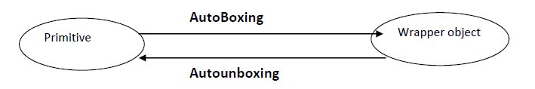
AutoBoxing and unboxing
Automatic conversion of the primitive to wrapper and wrapper to the primitive:-
What happens if a string like hello is passed to parseInt() method?
So, passing “Hello” an exception called NumberFormatException occurs since the parseInt() method cannot convert the given string “Hello” into an interger value.

Slide 19
Example
Ex :-
class Test
{
static Integer i=10;//i is wrapper object
static int j;//j is primitive variable
static void print(int i)
{
j=i;
System.out.println(j);
}
public static void main(String[] args)
{
print(i);
System.out.println(j);
}

